Slide 1
Weather Forecasting for Bangalore City
Faculty Coordinator – Subha Meenakshi S
Team Members :-
Aditya GS - 1BI20AI003
B K Shrutha Keerthi - 1BI20AI006

Slide 2

Abstract
Weather forecasting involves predicting atmospheric conditions, aiding in the anticipation of temperature, precipitation, and other elements. Utilizing advanced technology and meteorological data, forecasters analyze patterns to provide accurate and timely information for planning and preparedness. Continuous advancements in modeling and satellite technology enhance the precision of weather predictions on local and global scales.Bangalore features a tropical savanna climate with distinct wet and dry seasons, offering a generally moderate climate due to its elevated location. The coolest month is January, while the hottest is April. High elevation keeps winter temperatures above 14 °C and summer temperatures below 36 °C. Rainfall is received from both northeast and southwest monsoons, with September being the wettest month. Summer heat is moderated by frequent thunderstorms, occasionally causing power outages and local flooding. Notably, 2022 experienced a significant 368% increase in rainfall, leading to widespread flooding and power disruptions in Bangalore.

Slide 3
Introduction
The Python code presented conducts a thorough analysis of historical weather data for Bangalore spanning the years 1990 to 2022. Leveraging libraries such as Pandas, NumPy, Seaborn, Plotly Express, and Matplotlib, the code performs data cleaning operations, addressing missing values through interpolation. Subsequently, it generates diverse visualizations, including time series plots, year-wise averages, and month-wise heatmaps, providing valuable insights into the temperature and precipitation patterns over the years. The analysis also includes a comparative study of temperature and precipitation for the years 1990 and 2016, visualized through box plots and bar graphs. In essence, this code offers a comprehensive exploration of Bangalore's historical weather trends, facilitating a nuanced understanding of the city's climatic variations.

Slide 4
Literature Survey
SL.No | Paper title, Name of Journal , Year of Publication,Authors | Proposed Idea | Limitations
1 | Rajanikanth, J. & Rajini kanth, T V. (2017). An Explorative Data Analysis on Bangalore City Weather with Hybrid Data Mining Techniques using R. | By integrating advanced mining methods, the study unveils intricate patterns, enriching our understanding of the city's climatic nuances. | The effectiveness of hybrid data mining techniques is also contingent on the availability and diversity of high-quality data sources.
2 | Joshi, Hemlata & Tyagi, Deepa. (2021). Forecasting and Modeling Monthly Rainfall in Bengaluru, India: An Application of Time Series Models. | The research aims to enhance accuracy in predicting rainfall patterns, providing valuable insights for effective water resource management | The inherent complexity of weather systems, introducing challenges in accurately modeling and predicting monthly rainfall.

Slide 5
SL.No | Paper title, Name of Journal , Year of Publication,Authors | Proposed Idea | Limitations
3 | Machine Learning Approaches for Meteorological Applications,Authors: J. G. Li, S. Lee, and Q. Tang Year: 2019 | The study investigates the use of machine learning techniques like support vector machines, neural networks, and ensemble methods to enhance weather forecasting accuracy. | The study's limitations include high data requirements for effective model training, interpretability challenges, and potential overfitting due to intricate weather patterns and limited datasets.
4 | Weather Forecasting Using Machine Learning Techniques: A Comprehensive Review Authors: A. Kumar, P. Sharma, and R. K. Singh Year: 2018 | The paper reviews machine learning applications in weather forecasting, highlighting advantages and challenges, including model sensitivity and dynamic weather systems, making long-term predictions challenging. | The paper acknowledges limitations in machine learning models, including sensitivity to input features, long-term predictions challenges due to weather systems' dynamic nature, and the unpredictable nature of atmospheric conditions.

Slide 6
SL.No | Paper title, Name of Journal , Year of Publication,Authors | Proposed Idea | Limitations
5 | Comparative Analysis of Machine Learning Algorithms for Rainfall Prediction Authors: S. Gupta, A. Kumar, and R. S. Tiwari Year: 2020 | The paper evaluates various machine learning algorithms for rainfall prediction, highlighting their performance limitations, such as feature selection and data quality impact. | The paper highlights the limitations of machine learning algorithms for rainfall prediction, highlighting feature selection challenges and the impact of data quality on performance.
6 | Deep Learning for Weather Forecasting: A Review Authors: S. Wang, X. Li, and Y. Zhang Year: 2020 | The paper highlights the limitations of machine learning algorithms for rainfall prediction, highlighting feature selection challenges and the impact of data quality on performance. | The paper highlights the limitations of machine learning algorithms for rainfall prediction, highlighting feature selection challenges and the importance of data quality in enhancing prediction reliability.

Slide 7
Proposed System
The project outlines a system for weather data analysis in Bangalore. It encompasses data cleaning techniques like time-weighted interpolation and mean imputation. Machine learning models (Linear Regression, Ridge, Lasso, Random Forest) are implemented for temperature and precipitation prediction, with standardized features and model evaluation metrics.
Exploratory data analysis includes visualizations depicting trends, averages, and comparisons over time. The code emphasizes handling missing values and outliers, ensuring data robustness. Scatter plots visualize model predictions against actual values for comprehensive evaluation.
Temporal trends are explored through yearly and monthly analyses, offering insights into average temperature and precipitation. The code concludes with comparative visualizations between 1990 and 2016.
In essence, the system seamlessly integrates data preprocessing, machine learning, and exploratory data analysis, providing a holistic approach to understand and interpret historical weather patterns in Bangalore.

Slide 8
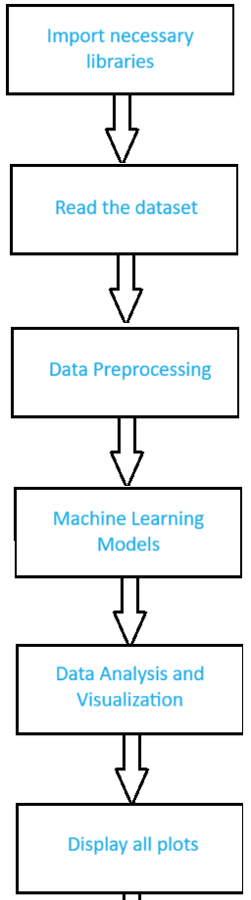
Import Libraries:
Libraries such as Pandas, NumPy, Seaborn, Plotly Express, Matplotlib, and scikit-learn are imported. These libraries are essential for data manipulation, analysis, visualization, and machine learning.
Data Loading and Cleaning:
The code reads a dataset ('Bangalore.csv') containing weather data into a Pandas DataFrame.
It converts the 'time' column to a datetime format and sets it as the index.Time-weighted interpolation is performed to fill in missing values, ensuring a continuous time series.NaN values are checked and imputed with the mean for any remaining gaps.
Machine Learning Models:
Three regression models (Linear Regression, Ridge Regression, Lasso Regression) are trained for both temperature ('tavg') and precipitation ('prcp').
Additionally, a Random Forest Regressor is used for these predictions.
The dataset is split into training and testing sets, and feature scaling is applied using StandardScaler.
Block Diagram

Slide 9
Model Evaluation:
The models are evaluated using Mean Squared Error (MSE) and R2 Score.
The evaluate_model function generates scatter plots comparing actual vs. predicted values for each model.
Data Analysis and Visualization:
Missing data percentage is calculated and printed.
Rows with more than three missing values are displayed.
Outliers, such as the date with the highest temperature ('tmax') and lowest temperature ('tmin'), are identified.
Plots are generated to visualize the trends in temperature and precipitation, including yearly and monthly averages.
Yearly and Monthly Analysis:
Yearly averages for temperature and precipitation are calculated and visualized.
Monthly averages are presented through line plots, grouped bar plots, and heatmaps.
Display Plots:
Various plots are displayed, including boxplots comparing temperature in 1990 and 2016, bar plots for precipitation in 1990 and 2016, and other relevant visualizations.

Slide 10
System Requirements
Hardware Requirements:
Software Requirements:
-CPU : Processor i5 or more
-RAM : 8GB
-Operating System
-Jupyter Notebook
-Anaconda Navig
-Python 3.8
Non Functional Requirements
Reliability:
The system should maintain a high level of accuracy in weather predictions, minimizing errors and ensuring consistent performance in diverse weather conditions.
Scalability:
The system must handle increased data volumes efficiently, accommodating future expansions or additional features without compromising performance.

Slide 11
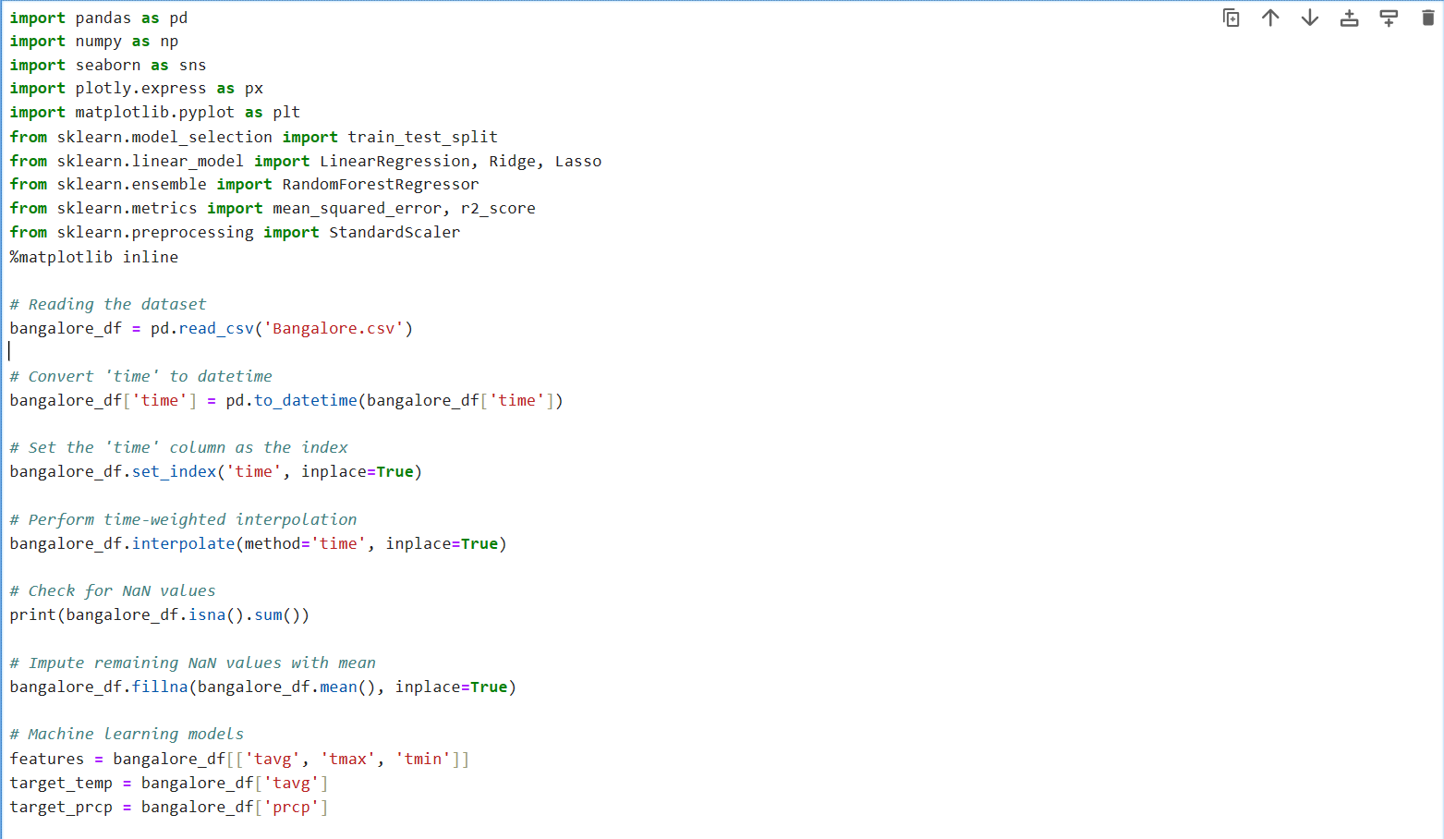
Code:

Slide 12
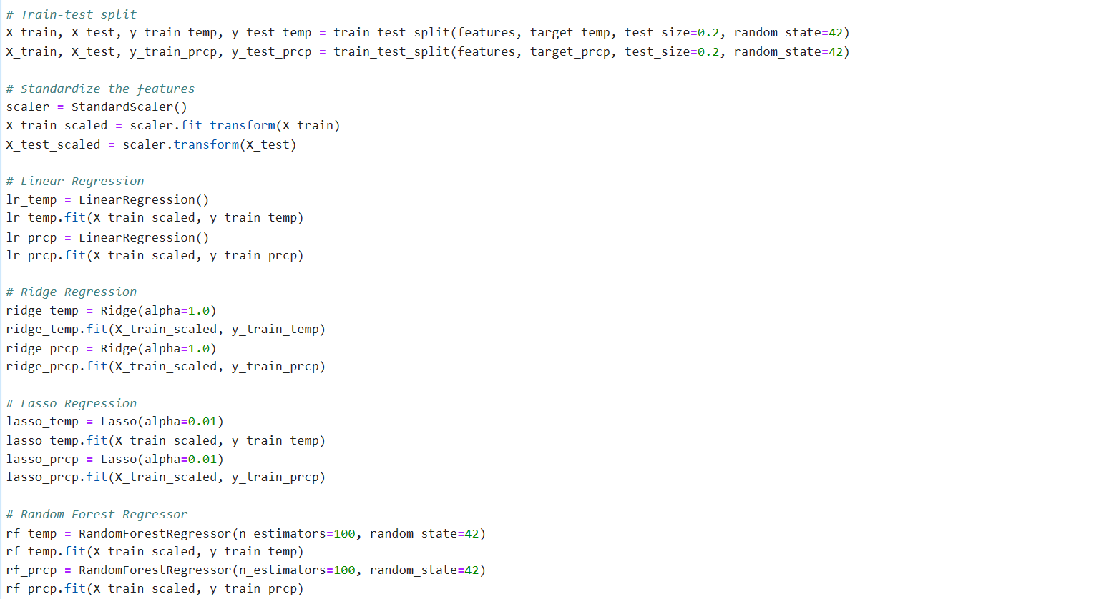

Slide 13
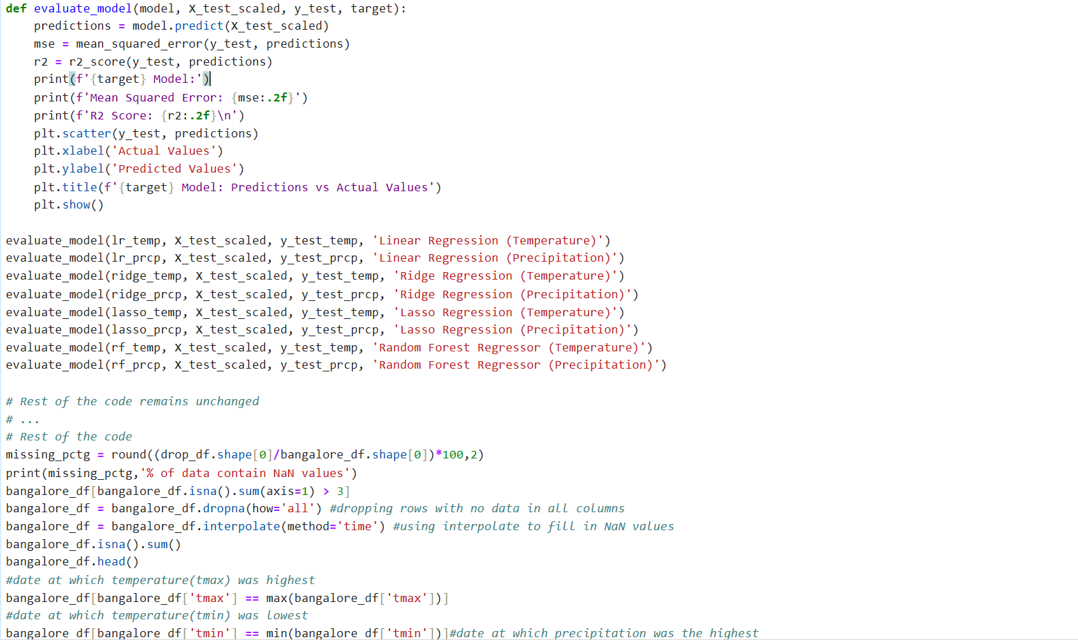

Slide 14
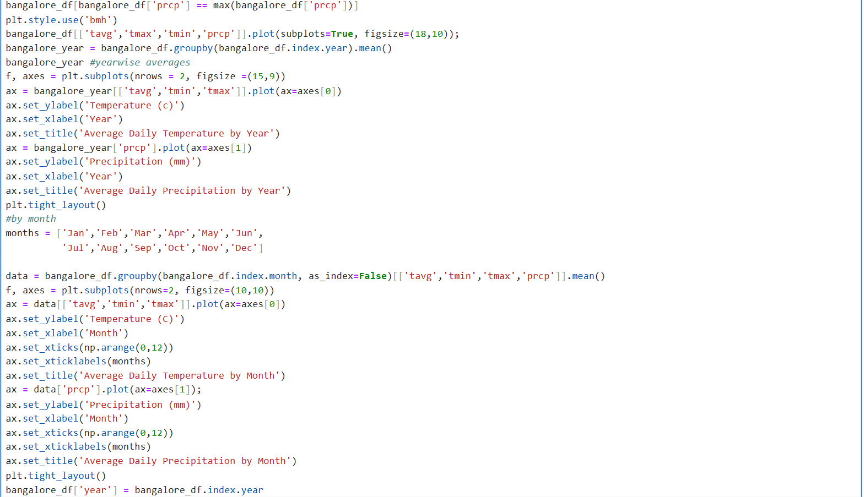

Slide 15
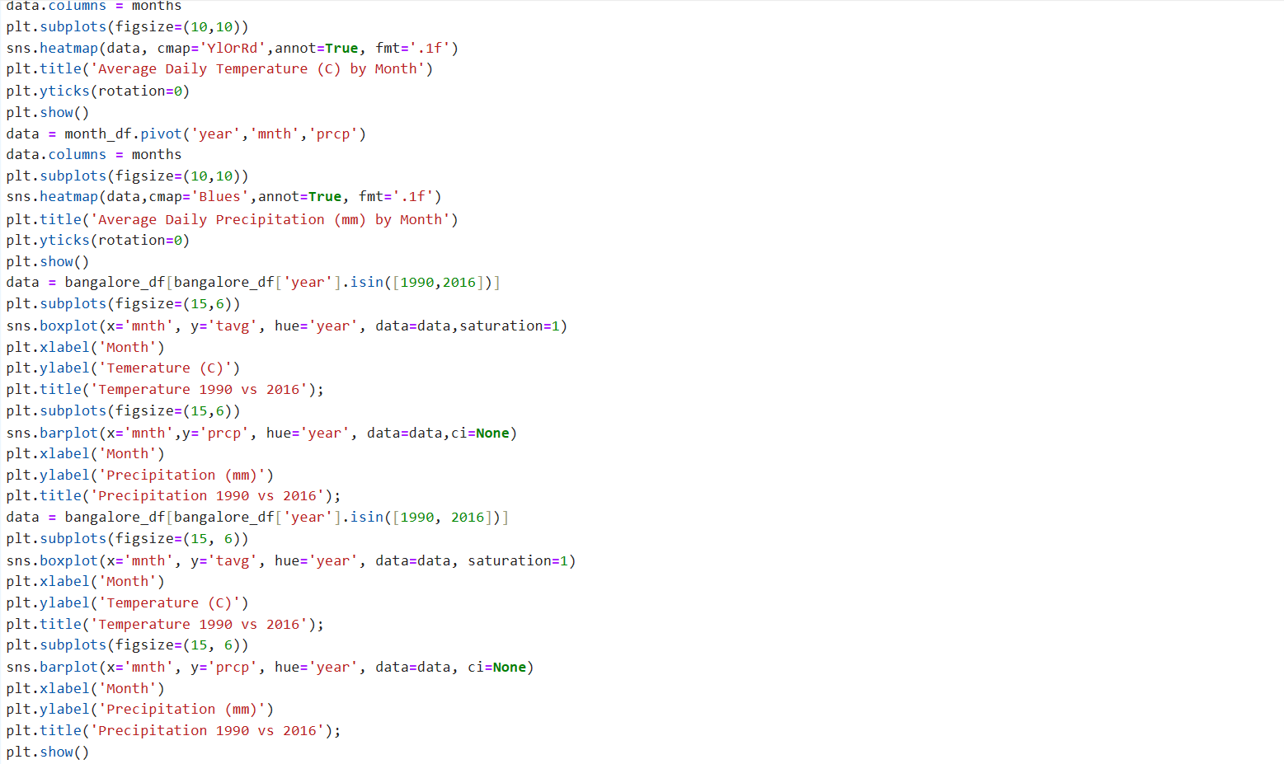

Slide 16
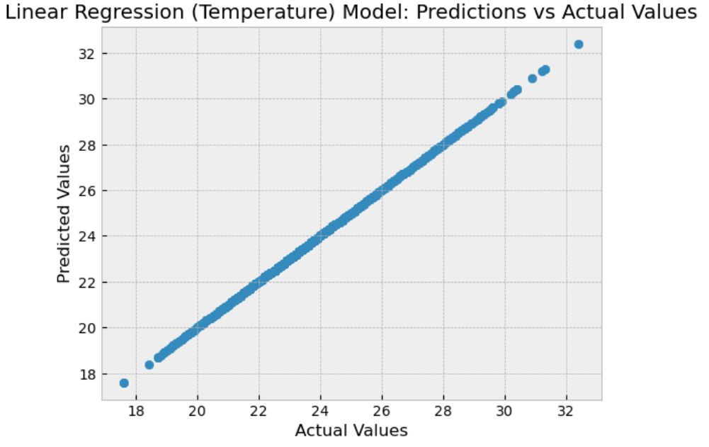
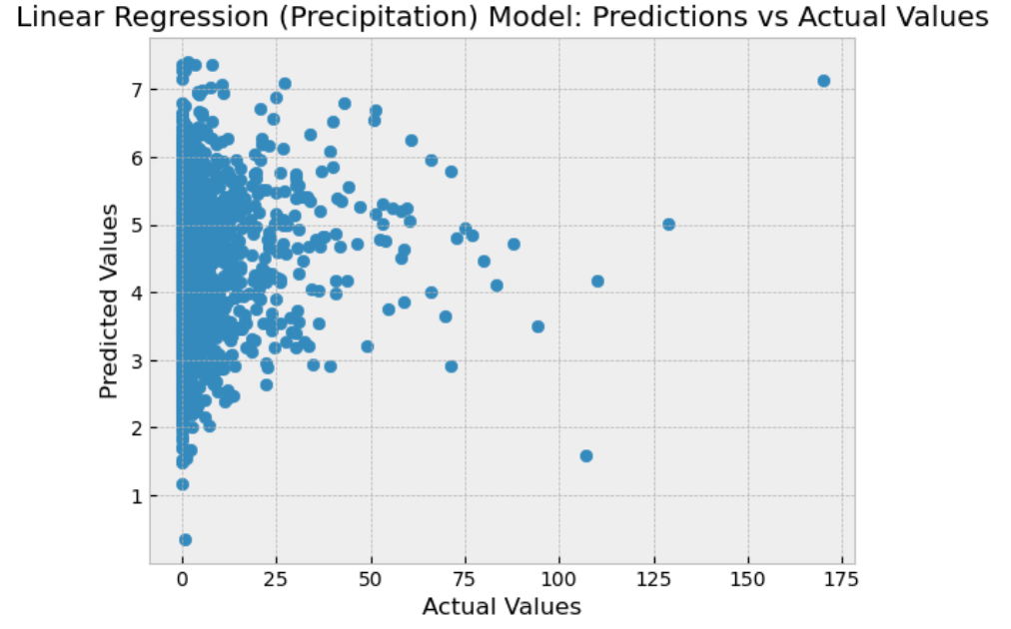
Screenshots

Slide 17
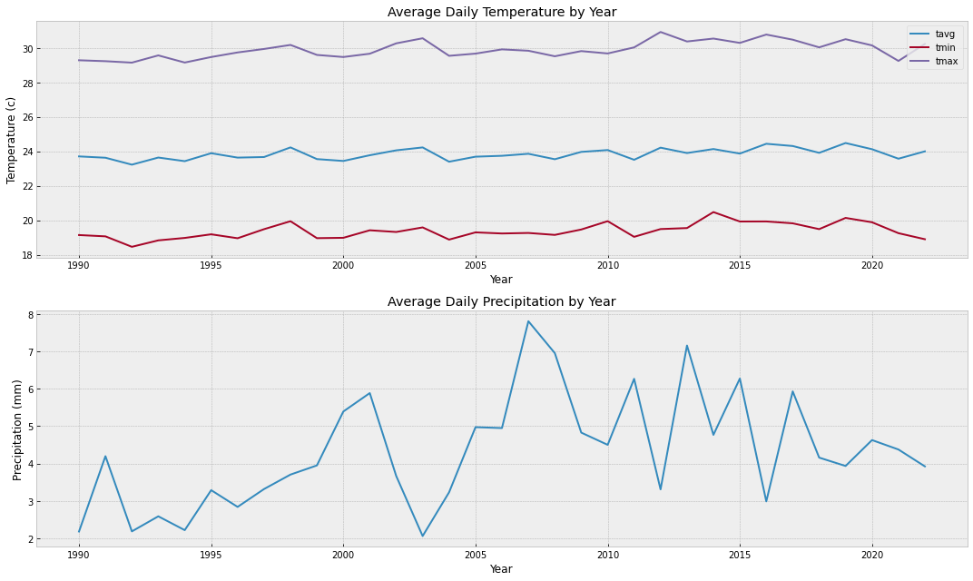
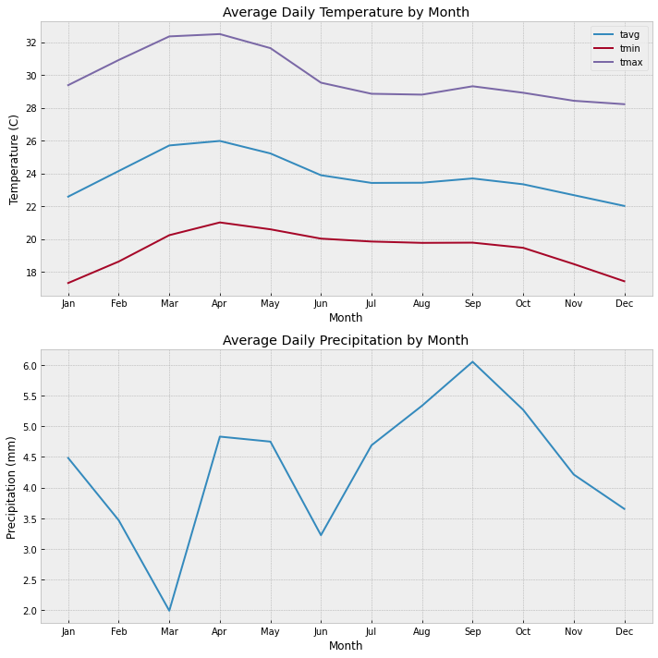

Slide 18
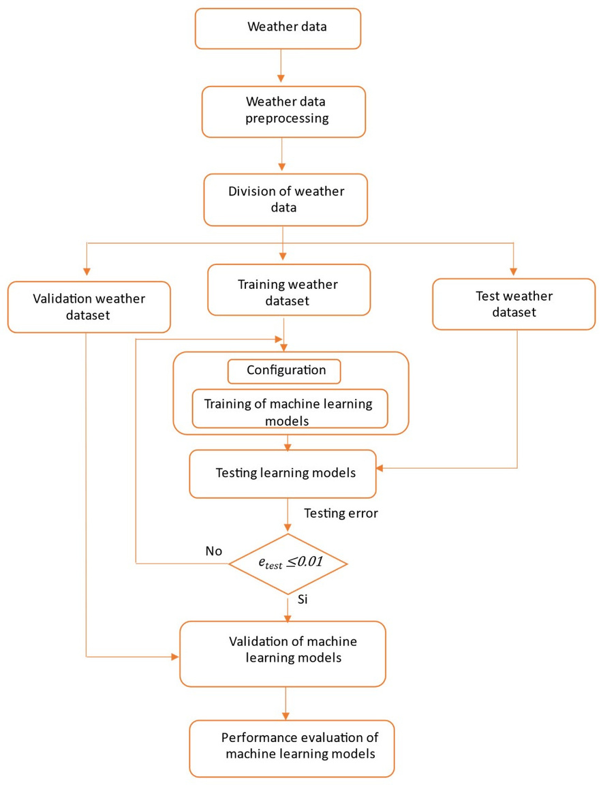
Module Design:

Slide 19
Thank You

